Slide 1
Structural optimisation of Lattice structures based on Machine Learning
Gauthier BRUNEL – Axel CHOQUET – François GLEYZON

Slide 2
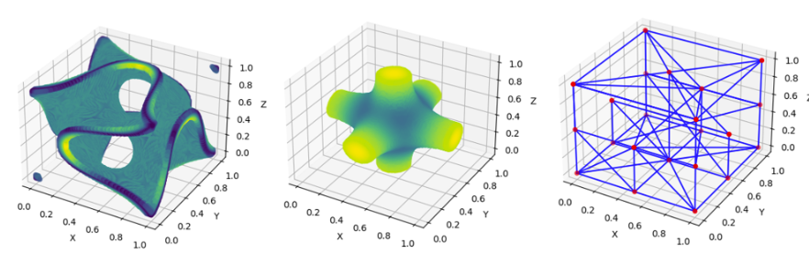
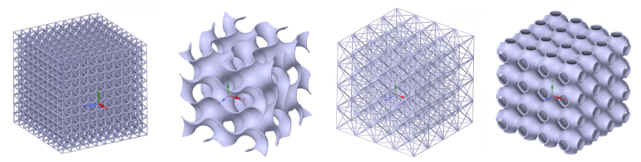
Lattice structures
Cellular Solids (CS)
Stochastic structures
Non-stochastic structures
Fischer-Kosch S TMPS / Schwarz P TMPS / Wireframe Lattice
Closed-cell foam
Open-cell foam
Honeycomb
Lattie structure
Improvements and advantages :
High strength
Absorption of energy
Lightweight
Reduction of vibrations
Cube lattice with centre supports / Gyroid facetted lattice / Cube lattice with side diagonal supports / Schwarz P faceted lattice

Slide 3
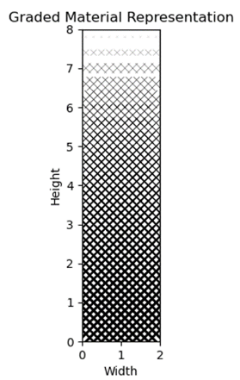
Functionally Graded Material
Graded Lattice offers more control over the strength and weight (variable density and porosity) → Improvement of the geometry.
FGM possible thanks to new additive manufacturing techniques.

Slide 4
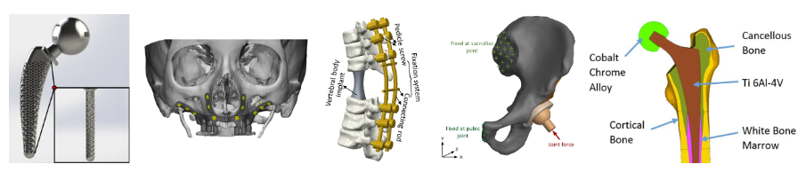
Topology optimisation in Biomedical engineering
Topology optimisation, a cutting-edge technique in geometric engineering, finds profound relevance and potential in medical and biomedical applications.
In these domains, the quest for optimal geometries is transformative, impacting human health and well-being.
Prosthetics and orthopaedics
Pathways to restored mobility, functionality, and quality of life.
→ Topology optimisation enables tailored solutions for individual anatomical and physiological needs enhance with lattice structure.

Slide 5
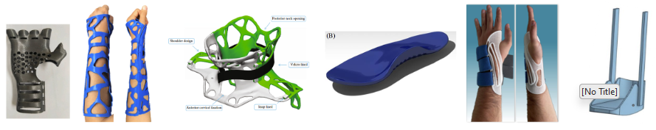
Prosthetic and Orthopaedics
Objective: Enhance the geometry of orthotic devices using topology optimization and graded lattice structures.
Material selection criteria are significantly reduced for orthoses, which do not require biocompatibility considerations like prostheses.
Orthosis : external devices designed to support, align, stabilise, or correct various parts of the body

Slide 6
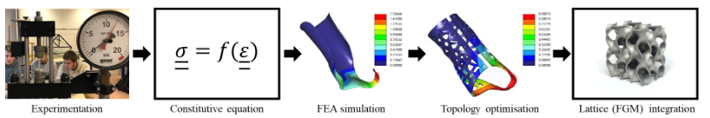
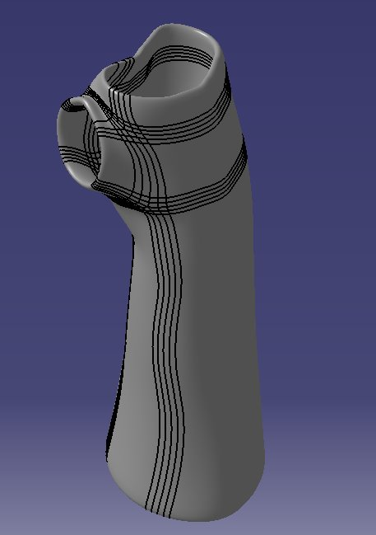
Workflow of the project
Experimental procedures will be undertaken to derive the constitutive equation → Setting material properties.
Computer-Aided Design (CAD) and Finite Element Analysis (FEM).
Topology optimisation based on the FEM results given a certain set of boundary conditions reflecting the closest the reality.
Lattice integration in the optimised geometry thanks to Machine Learning (ML).
Wrist Orthosis : starting geometry shared by the biomechanical engineer
Jesús Hernández.
Size limit : 30 x 30 cm

Slide 7
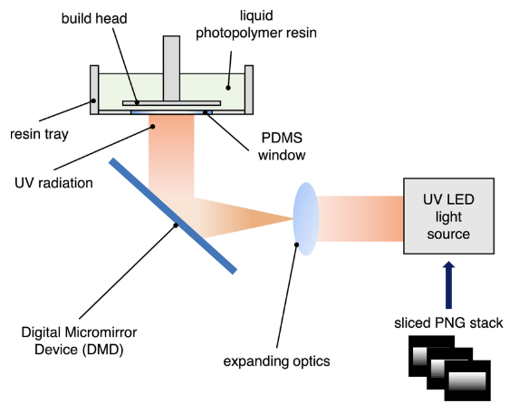
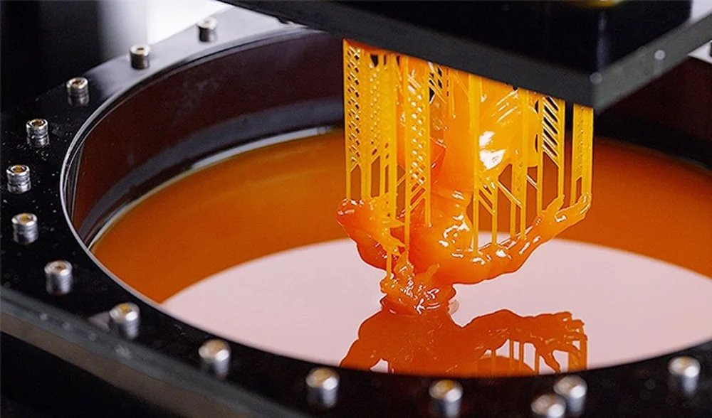
Digital Light Printing (DLP)
DLP uses UV light to cure resin layer by layer.​
Applications : jewellery and dental. ​
Advantages: ​
Fast printing speed.​
High precision and detail (50µ details).​
Disadvantages:​
Higher initial cost.
Expensive resin, needs careful handling.​
Limited part size.​

Slide 8
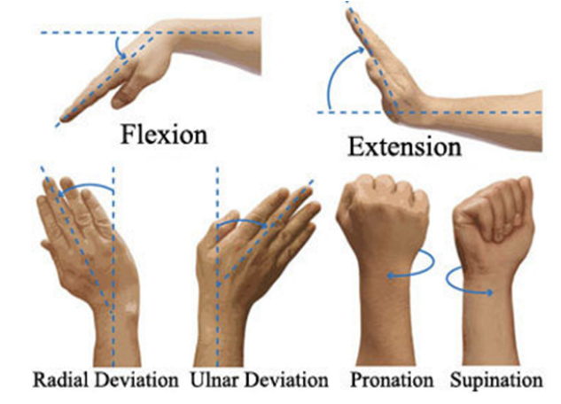
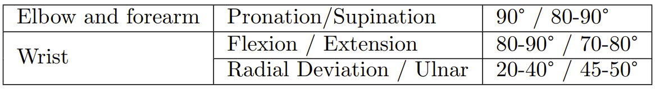
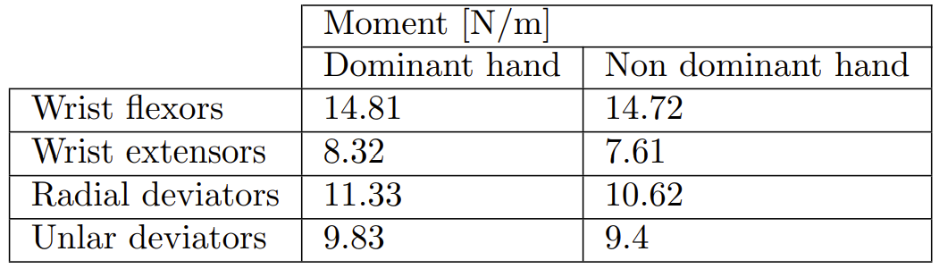
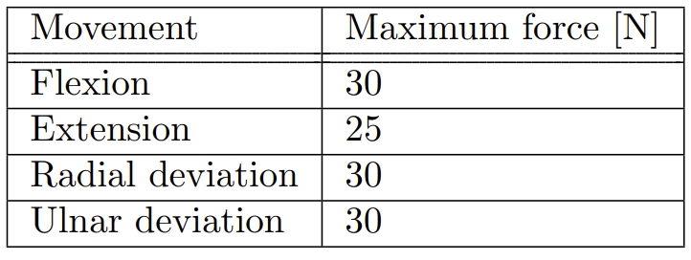
Boundary and loading conditions
Based on typical movement of the wrist, bone displacement et kinaesthetic information.
The boundary and loading conditions need to be as closed to the reality in order to perform a faithful simulation.
Such movement were converted through forces and moments in scientific papers :
→ Different movements and types of BC should be studied (comparison between force and moment)

